Slide 1


overview of the US and Europe educational systems (difference and similarities)

Slide 2
Plan
01
02
03
04
05
06
07
Introduction
University vs. College
Degree Structure
Tuition and Financing
Admissions and Selection
Teaching and Learning Styles
Conclusion

Slide 3

Introduction
Notes:
Greetings to all, This presentation discusses the educational systems in Europe and the United States, focusing on post-high school pathways and their impact on young adults. Despite their shared commitment to education, the US and Europe have different approaches, impacting learners and organizations. The presentation aims to provide a better understanding of the options, difficulties, and possibilities students face in these two unique locations.

Slide 4
University vs College

Slide 5
THE US
EUROPE
Used interchangeably
College covers wide range of institutions
Offers both undergraduate and graduate degrees
Standardized nomenclature
College for secondary education or vocational training
College Does not grant degrees
University grants academic degrees

Slide 6
Degree Structure

Slide 7
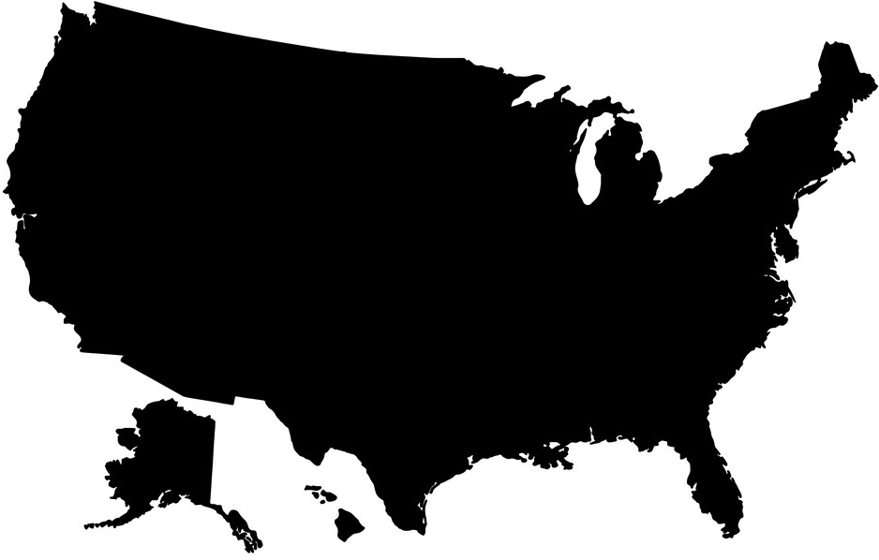

The US degree structure offers flexibility and diversity, starting with a four-year undergraduate program and extending to postgraduate programs like master's, professional, and doctoral degrees.
The Bologna Process in Europe has standardized the education system, reducing bachelor's to three years, simplifying the educational process and enabling quicker entry into the labor market, but necessitating early career decisions.

Slide 9

Done by
Mohamed Amine Fakhre-Eddine
Mohamed Amine Fakhre-Eddine
Mohamed Amine Fakhre-Eddine

Slide 10




Thank you for reading
You can find me on
@aLonewolf_____
mohamedfakhreeddine2019@gmail.com
Mohamed Amine Fakhre-Eddine

